Slide 1
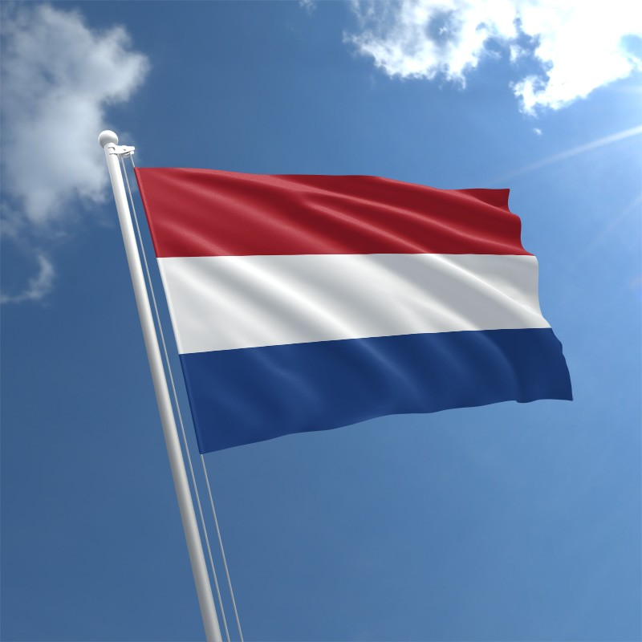
International and Cultural Foods Project
Devon Gardner and Zoey Denkers- Georgia Southern University and The Hague University of Applied Sciences

Slide 2
introduction
Zoey and Devon are both students who study food and nutrition. We both do not follow specific diets other than just trying to eat healthy and giving our bodies the best fuel that we can.
We both believe in the importance of exercise and maintaining a healthy body weight. Devon prefers getting exercise from aerobic and anaerobic training, while Zoey enjoys participating in sports such as soccer.
We both eat 3 meals a day with snacks and mostly consume water. Devon enjoys indulging in coffee a few times a day, while Zoey enjoys having a cup of tea once or twice a day.
We both enjoy the traditions our cultures provide, but also believe it is important to not eat very rich, fatty foods all of the time.

Slide 3
Devon & Zoey’s Eating habits
• Zoey’s cultural background: All Dutch
• Diet following: Not following a specific diet, just trying to eat healthy
• Food taboos: Insects and Rabbit
• Food eaten for health reasons: No foods eaten for health reasons
• Devon’s cultural background: North America, South East Region
• Diet following: Nonspecific. Little meat, many fruits and vegetables
• Food taboos: Mushrooms, insects
• Food eaten for health reasons: Eats grapes with seeds dude to high nutritional value of the seeds
Both do not follow specific diets other than trying to eat healthy and follow general recommendations.

Slide 4
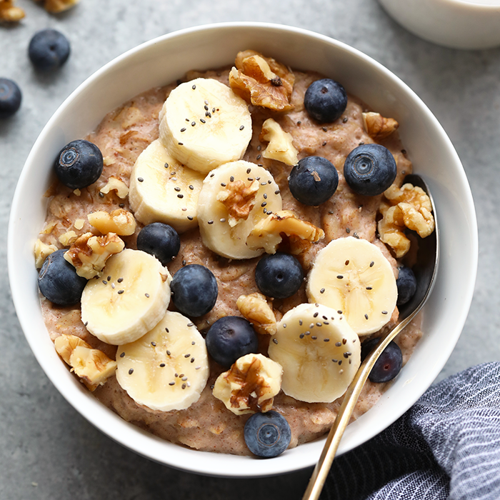
Breakfast
Netherlands
Sandwich mostly with “hagelslag”, peanut butter, cheese and meat.
Brinta / oatmeal
Yogurt with granola
United States
Eggs with cheese and salsa, side of turkey bacon and coffee
Oatmeal with banana
Granola bar
We both have similar diets for breakfast. We enjoy yogurt with added granola or fruits and things like toast with peanut butter

Slide 5
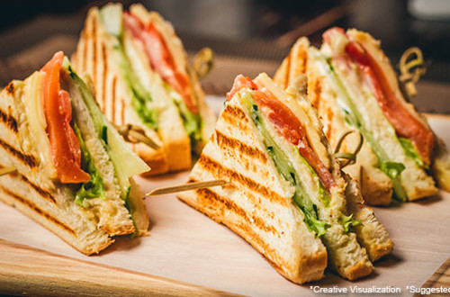
Lunch
Netherlands
Sandwich or crackers with cheese, meat, or eggs
Sometimes homemade salads
United States
Turkey and cheese sandwich with hummus and pita
Leftovers from previous nights dinner
Our lunches are almost identical!

Slide 6
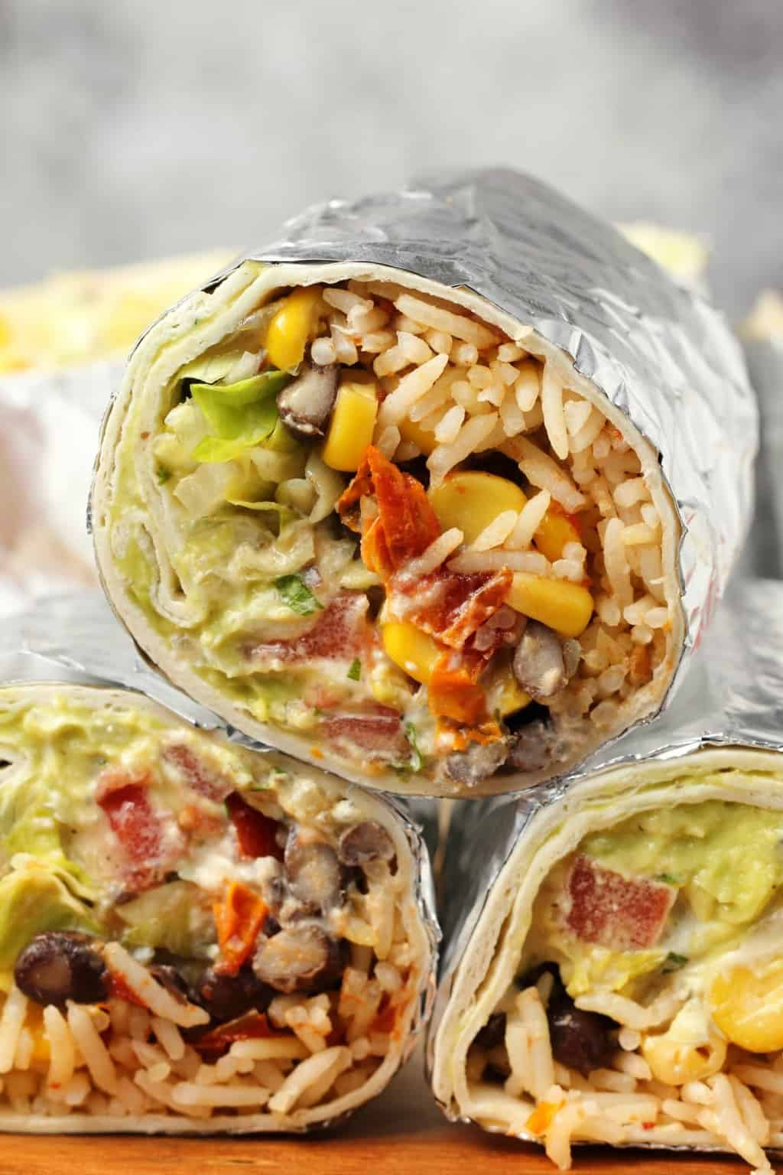
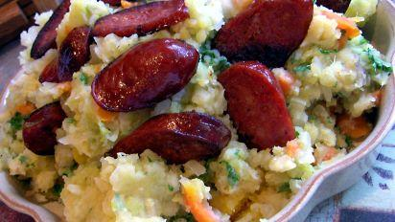
Dinner
Netherlands
Potatoes, vegetables and a piece of meat, like beef, chicken or pork
Stampot with “rookworst’’
Pasta
Fries with frikandel or kroket.
United States
Black bean burger, vegetable side, rice
Burrito with avocado and salsa
Spaghetti with ground turkey meat
Grilled or fried pork chop with green beans or collard greens and biscuits
Our dinners are very different. In the Netherlands, they commonly incorporate potatoes into their evening meals. In America, meat seems to always be the main dish of interest.

Slide 7
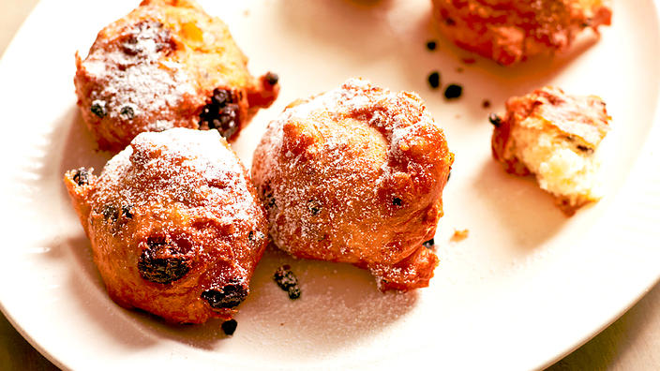
Snacks & Drinks
Netherlands
Stroopwafel (syrup waffle)
Bitterballen (round balls with beef inside)
Oliebollen (similar to deep fried doughnut balls)
Haring (herring)
Coffee or tea, soda, lemonade, water.
United States
Chips & dip (salsa, queso, hummus)
Yogurt with granola
Popcorn
Chocolates and other candies
Ice cream or frozen yogurt
Water or coffee
Sodas and Sweet tea
We consume very similar drinks in the U.S. and Netherlands. In the Netherlands they consume syrup waffles as a snack, which in the U.S. is considered a breakfast item. They also consume herring as a snack, which is eaten more often as a dish during dinner in the U.S.

Slide 8
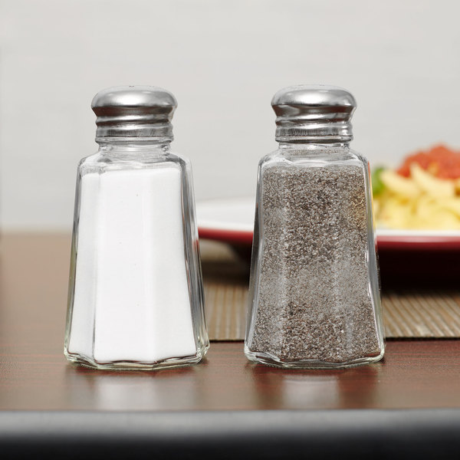
Common spices and herbs
Netherlands
Salt & Pepper
Garlic
Nutmeg
Aromat
Mayonnaise
United States
Salt & Pepper
Crushed Red Pepper
Garlic
Paprika
Cumin
Salt is very overused in the U.S. and many initiatives to reduce sodium intake in the U.S. have been made in order to reduce cases of hypertension.
The most common herbs and spices used in the NL are typically complementary of the sausages they consume. Meats such as sausage and turkey tend to be very salty and flavorful.

Slide 9
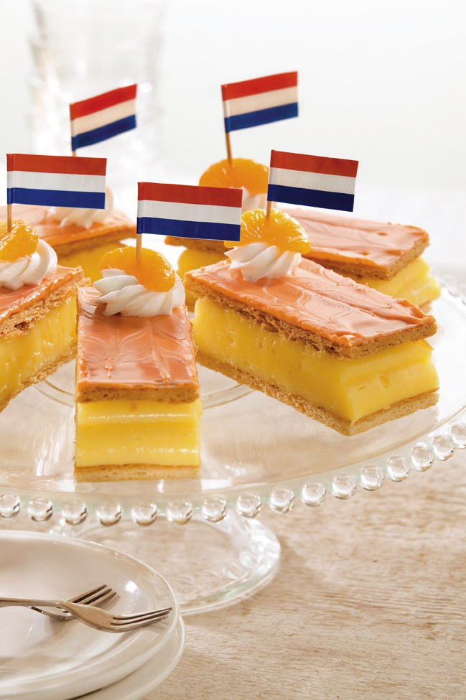
Holidays and the food we eat
Netherlands
Sinterklaas-Kruidnoten (Small round cookies with gingerbread spices)
Christmas- Gourmet foods and turkey
New Years Eve- Oliebollen (Small doughnut balls)
Easter- Small Easter Eggs
Kingsday- Orange tompouce
United States
Christmas- Turkey or baked ham. Mashed potatoes, casseroles, many desserts like pies. Eggnog.
Easter- Candy from easter eggs, similar foods to Christmas.
4th of July- Candy, grilled foods
Thanksgiving- Turkey, stuffing, casseroles, biscuits, vegetable sides, cranberry sauce. Pumpkin pie.
Halloween- Variations of different candies.

Slide 10
Birthday traditions
Netherlands
Birthday cake
Chips and borrelnootjes
Cubes of cheese
Slices of sausage
Bitterballen
United States
Cupcakes
Birthday cake
Brownies and Icecream
Snacks and candy
It is common for both cultures to have gatherings of family and friends for birthday celebrations.
Zoey’s family likes to go out to eat and let the person who’s birthday it is chose where they eat to celebrate.
In Devon’s family, they get to choose a favorite meal and dessert item to be prepared for them, and the family enjoys it together, but when with friends, they celebrate by going out to eat.
Bitterballen is a common Dutch snack served at gatherings consisting of beef (usually veal) and can then be baked or fried. They are very similar to what is considered meatballs in the U.S.

Slide 11
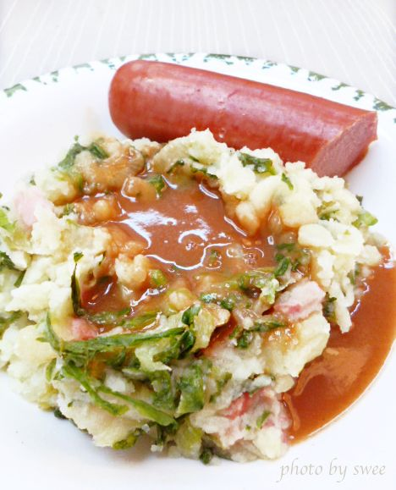
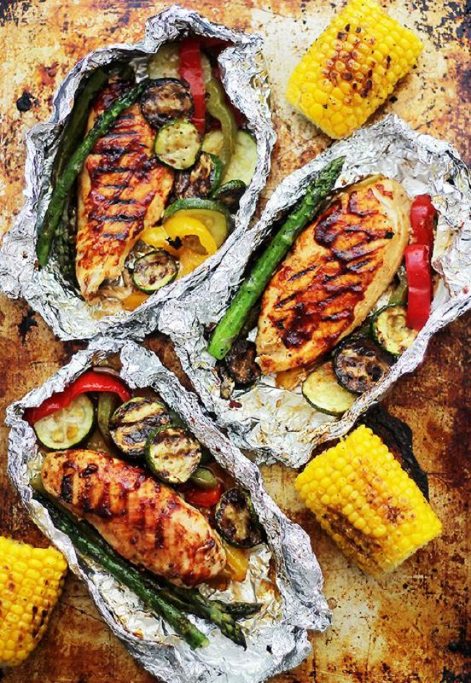
what dish could be served to help a visitor understand my heritage?
Netherlands
I would serve “stampot.” It’s mashed potatoes with vegetables in it. Mostly it’s served with “rookworst”, which is like a smoked sausage.
United States
I would serve grilled vegetables along with grilled BBQ chicken and mac n cheese. This is what is commonly served at get togethers and parties in my family.

Slide 12
Similarities and Differences
Similarities-
Both celebrate birthdays and eat special treats such as birthday cake.
Both consume turkey and gourmet foods on big holidays such as Christmas.
Uses salt, pepper, and garlic.
Three meals a day with one or two snacks in between meals.
Differences-
In the Netherlands they consume more potatoes and sausage than in the U.S.
Much more candy consumed in the U.S. than Netherlands
Can legally drink alcohol after age 18 in Netherlands, must be 21 in the U.S.
Dutch people tend to consume much more tea than Americans

Slide 13
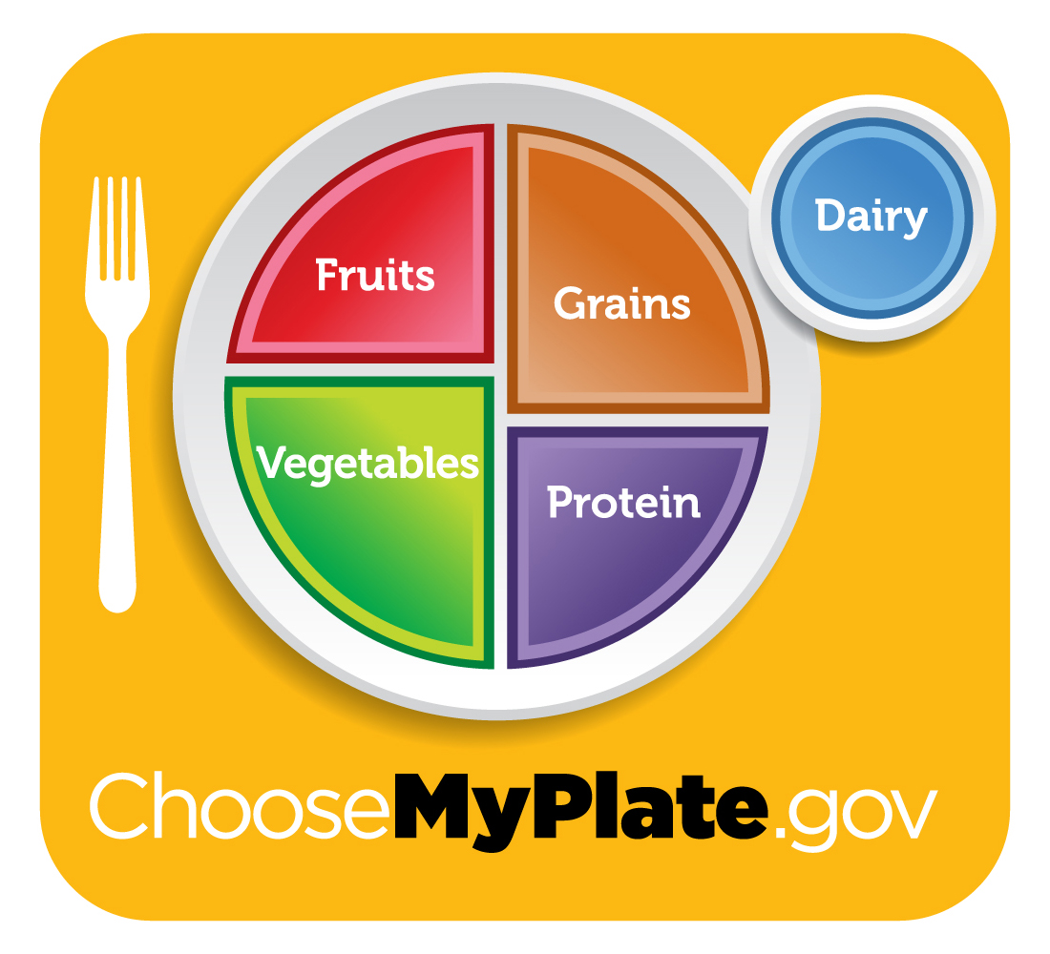
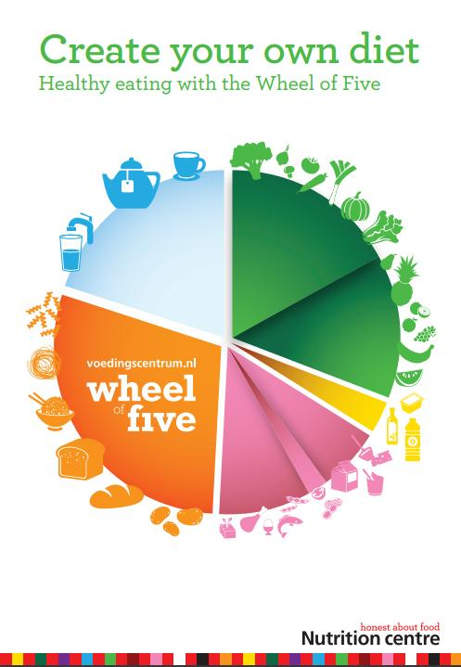
Guidelines
Netherlands
Follows the Wheel of Five
200 grams vegetables and fruits a day.
90 grams whole wheat products a day.
15 grams unsalted nuts.
A few portions of dairy a day.
Eat fish once a week.
Drink 3 cups of tea daily.
At least 150 minutes of exercise per week
United States
Follows MyPlate and the United States Dietary guidelines.
Recommendations include
2 ½ cups vegetables per day.
2 cups fruit per day.
6 oz eq whole wheat grains per day.
3 cups of dairy per day.
5 ½ oz protein foods per day.
27 grams per day of oil.
less than 2300 mg sodium per day
150-300 minutes of exercise per week
Our guidelines are similar, although the NL is based on grams per day while the U.S. is based on cups. Tea is not consumed as frequently in the U.S. so there is not a recommended guideline for how many cups should be consumed per day

Slide 14
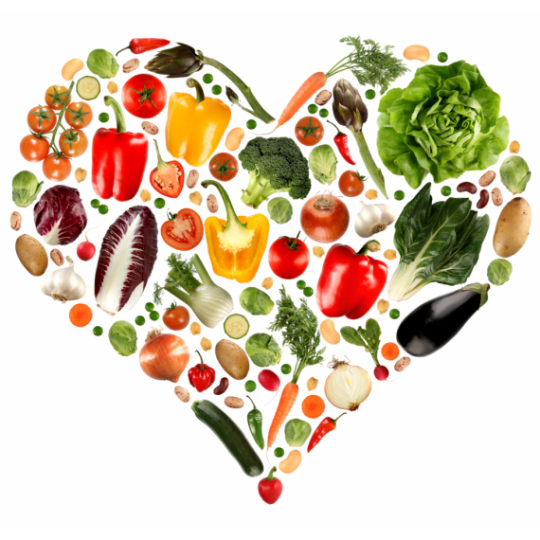
difference in the guidelines
One of the differences is that in the USA they say low fat or skim milk and in the Netherlands they just say dairy. I think that is because in the USA they reduce the saturated fat intake.
In the Netherlands dietary guidelines, they recommend drinking 3 cups of tea per day, whereas in the USA we do not have recommendations for tea consumption.
In the Netherlands you need to eat the same amount of fruit and vegetables per day, whereas in the USA you need to eat more vegetables than fruit.
In the U.S., MyPlate and U.S. Dietary Guidelines are followed and in the Netherlands they follow the Wheel of Five, which is relatively similar to MyPlate.
U.S. guidelines recommend that adults participate in atleast 150 minutes of physical activity per week, whereas the Netherlands guidelines recommend atleast 150-300 minutes per week.

Slide 15
Summary
In conclusion, Dutch and American cultures are very similar, yet very different in significant ways.
Although we grew up differently and speak different languages, we both enjoy hanging out with friends and family, going to social events and trying new foods.
The Netherlands has very interesting traditional foods based on what was available to the people who lived there when these foods were created.
It was interesting learning about the behaviors and eating habits of someone who lives on an entirely different continent than me. This project provided a unique opportunity to communicate with someone outside of our usual comfort zone.

Slide 16
References- Apa citations
Www.facebook.com/AmsterdamTouristInfo. (n.d.). Dutch Food - 15 Delicious & Famous Dishes in Amsterdam. Retrieved April 4, 2019, from https://www.amsterdamtourist.info/eating-drinking/famous-dutch-food/
Pier. (n.d.). Dutch Culture - Family. Retrieved March 30, 2019, from https://culturalatlas.sbs.com.au/dutch-culture/dutch-culture-family
Dietary Guidelines. (2018, September 05). Retrieved March 30, 2019, from https://www.choosemyplate.gov/dietary-guidelines
Netherlands. (n.d.). Retrieved March 29, 2019, from http://www.fao.org/nutrition/education/food-dietary-guidelines/regions/countries/netherlands/en/
Netherlands. (2019, April 27). Retrieved March 30, 2019, from https://www.who.int/countries/nld/en/

